Slide 1
COVID-19 “Flatten the Curve” Hackathon
#personalfaceofscience

Slide 2
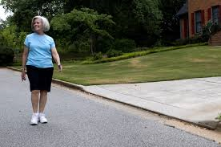
6 Feet of Distance
Amy is an avid hiker. Hiking not only provides exercise, but getting close to nature helps her manage stress and keeps things in perspective. Social distancing is impossible on a narrow trail when passing other hikers. Amy will commit to walking in her neighborhood instead where she can stay 6 feet from others on the path.
Will You Commit to a 6 Foot Distance to Flatten the Curve? Y N
www.pixnio.com
Notes:
https://www.health.gov.au/news/health-alerts/novel-coronavirus-2019-ncov-health-alert/how-to-protect-yourself-and-others-from-coronavirus-covid-19/social-distancing-for-coronavirus-covid-19

Slide 3
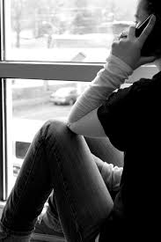
Do Not Gather
Mary is a teenager. She enjoys spending time with her friends. They often go to the mall or hang out and listen to music. During quarantine Mary does not gather with friends, so instead she meets with them remotely on the internet or telephone.
www.pixabay.com
Will You Commit To Avoid Group Gatherings To Flatten The Curve? Y N
Notes:
https://www.cdc.gov/coronavirus/2019-ncov/prevent-getting-sick/social-distancing.html

Slide 4
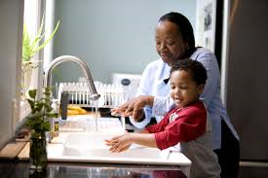
Wash Hands
Kalinda is a single mother of three children. They live in a rural community. The community has been quarantined and open only to community residents in order to reduce Sars CoV 2 transmission from outside. There are nurses and small medical clinics available in this area but doctors are available mostly using telemedicine options. A severe COVID-19 illness would require air transport to a hospital. Kalinda teaches her children how to properly wash their hands.
www.pixnio.com
Will You Commit To Frequent Hand Washing To Flatten The Curve? Y N
Notes:
https://coronavirus.tas.gov.au/__data/assets/pdf_file/0035/86759/Hand_Washing_Procedure_-_COVID-19_Fact_Sheet.pdf

Slide 5
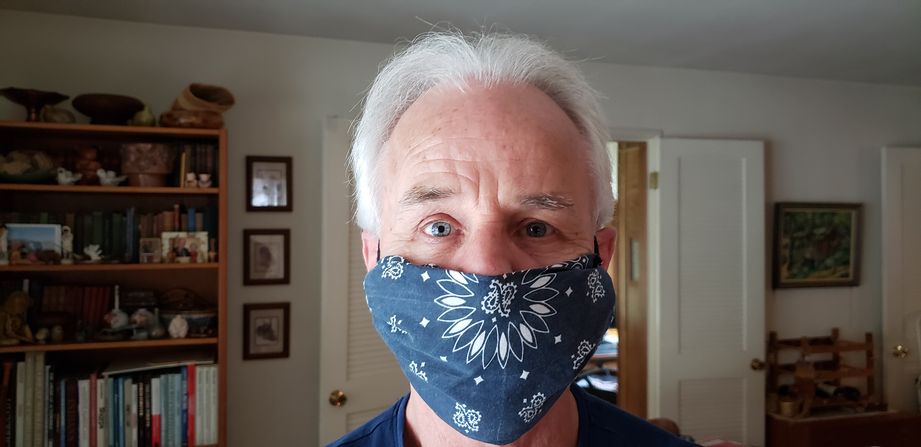
Wear A Face Mask
Joe is taking care of his elderly mother, Mae. Since Mae is at an age with increased risk for COVID-19 serious illness, it is important that he doesn’t expose her to the virus. While out doing essential errands like shopping for food, wearing a face mask will help reduce the risk of Sars CoV 2 exposure. Joe makes his own face mask to cover his nose and mouth while out running essential errands.
Will You Commit To Wearing A Face Mask While Doing Essential Errands? Y N
Notes:
https://www.cdc.gov/coronavirus/2019-ncov/prevent-getting-sick/diy-cloth-face-coverings.html

Slide 6
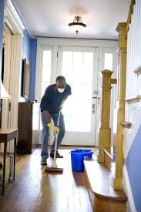
Wash and Disinfect Surfaces
Caleb is an essential worker. His partner, Wayne, has COPD. Wayne’s lung condition increases his risk of severe illness with COVID-19. Caleb and Wayne regularly wash and disinfect surfaces, door knobs and other frequently touched surfaces in their home.
www.pixnio.com
Will You Commit To Regular Cleaning Of Frequently Touched Surfaces To Flatten The Curve? Y N
Notes:
https://www.cdc.gov/coronavirus/2019-ncov/prevent-getting-sick/disinfecting-your-home.html

Slide 7
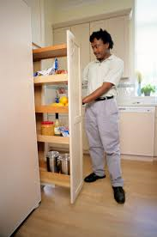
Keep A Supply of Food and Medicine
Blake has diabetes and high blood pressure. His health conditions increase his risk of respiratory complications due to COVID 19. Blake is keeping a 2-week food supply and 30 days of medication on hand to minimize his essential trips to the market and pharmacy. When he must make essential trips for food and medication, he wears a mask over his nose and mouth.
www.publicdomainfiles.com
Will You Commit To Minimizing Essential Errand Frequency In Order To Flatten The Curve? Y N
Notes:
https://www.cdc.gov/coronavirus/2019-ncov/daily-life-coping/essential-goods-services.html
https://www.health.nsw.gov.au/emergency_preparedness/planning/Factsheets/emergency-pantry-list.pdf

Slide 8
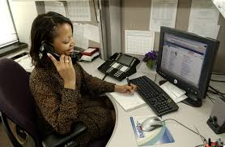
Make A Plan
Andrea is a young professional. She lives close to her parents who are retired, and to her cousins who are essential workers. During the quarantine, Andrea is able to remotely work from home. Andrea, her parents, and her cousins have a plan. Their plan is made in case one of the households become ill with the COVID-19 virus. This plan details how this family network will safely supply groceries, supplies and medication to the infected household as well as who will provide care to sick individuals.
www.commons.wikimedia.org
Will You Make A Plan to Help Flatten The Curve? Y N
Notes:
https://www.cdc.gov/coronavirus/2019-ncov/daily-life-coping/get-your-household-ready-for-COVID-19.html

Slide 9
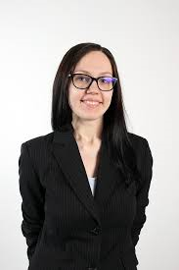
Stay Home
Martha is a successful entrepreneur. She has a comfortable life in the city and a country home. She enjoys frequent vacations. She would like to travel now, but stays home to stop the spread of COVID-19.
www.commons.wikimedia.org
Will You Stay Home To Flatten The Curve? Y N
Notes:
https://www.hopkinsmedicine.org/health/conditions-and-diseases/coronavirus/coronavirus-social-distancing-and-self-quarantine

Slide 10
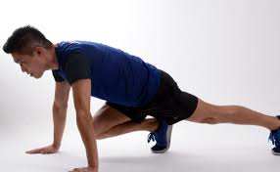
Manage Stress
Kenneth is a nonessential gig worker. Quarantine has impacted his income. Ken is stressed about the COVID-19 epidemic. To take care of his health and minimize anxiety, Ken takes breaks from the news, meditates regularly, eats a healthy diet and gets physical activity daily.
www.pixnio.com
Will You Commit To Stress Management To Help Flatten The Curve? Y N
Notes:
https://nutrition.org/making-health-and-nutrition-a-priority-during-the-coronavirus-covid-19-pandemic/
https://www.apa.org/practice/programs/dmhi/research-information/social-distancing
https://health.gov/news/202004/staying-active-while-social-distancing-questions-and-answers

Slide 11
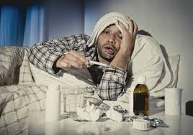
Stay Away From Others When Sick
Jared is sick. He has a cough, shortness of breath, and a fever. When he coughs he coughs into his elbow. He stays at home and away from other people, and he calls his doctor.
www.commons.wikimedia.org
If You Should Become Ill, Will You Stay At Home and Contact Your Physician To Flatten The Curve? Y N
Notes:
https://www.cdc.gov/coronavirus/2019-ncov/if-you-are-sick/steps-when-sick.html

Slide 12
Share Your Social Distancing Strategies
Post your social distancing successes and strategies here:
Stay home
Stay 6 feet from others outside the home
Do not gather
Wear a face mask
Wash hands
Wash and disinfect surfaces frequently
Keep a supply of food and medicine
Manage stress
Make a plan
Isolate when sick
Notes:
Have a comment space
Promotes self-efficacy
*How do we troubleshoot trolls, inappropriate photos and language, etc….? Is there a legal aspect to soliciting posts?

